Slide 1
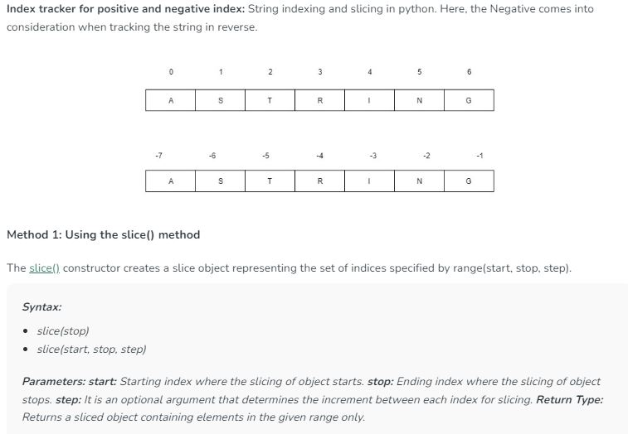
String Slicing

Slide 2
str = 'ABCDEFGHIJ‘
print(str[1:1]) # No Output
print(str[1:4]) #BCD
print(str[2:6]) #CDEF
print(str[3:]) #DEFGHIJ
print(str[:]) #ABCDEFGHIJ
print(str[:6]) #ABCDE
str = 'ABCDEFGHIJ‘
print(str[:-1]) #ABCDEFGHI
print(str[:-3]) #ABCDE
print(str[-3:]) #GHIJ
print(str[-7:-3]) #DEFG
print(str[-7:]) #DEFGHIJ

Slide 3
str = 'ABCDEFGHIJ'
print(str[-4:-1]) #GHI
print(str[-4:-1:1]) #GHI
print(str[-4:-1:2]) #GI
print(str[-1:-4:-1]) #JIH
print(str[-2:-5:-2]) #IG
str = 'ABCDEFGHIJ'
print(str[1:4:1]) #BCD
print(str[1:6:2]) #BDF
print(str[2:6:3]) #CF

Slide 4
str = 'ABCDEFGHIJ‘
print(str[-1::-1]) # JIHGFEDCBA
print(str[-1::-2]) # JHFDB
print(str[-1::-3]) # JHFDB
str = 'ABCDEFGHIJ‘
print(str[:-4:-1]) #JIH
print(str[:-5:-2]) #JH
print(str[:-5:-3]) #JG
str = 'ABCDEFGHIJ‘
print(str[:-4:-1]) #JIH
print(str[:-5:-2]) #JH
print(str[:-5:-3]) #JG

